Slide 1

Glimpses of Grace: The Joyful Catholic Educator
Les Miller
Notes:
Gratitude
Hope for today: Delve into the question-What is a joyful catholic educator?
My connection with HNM

Slide 2



The Felician Charism
Notes:
My experience with Felicians
Quote for The Felician Sisters' Mission and Heritage Week: The Lord has done great things for us, we are filled with joy.
Felicians: Franciscan, education, justice, community, ecological concerns.
Joy that permeated the community such as Sr. Josette, Sr. Dorothy, Sr. Celestine

Slide 3
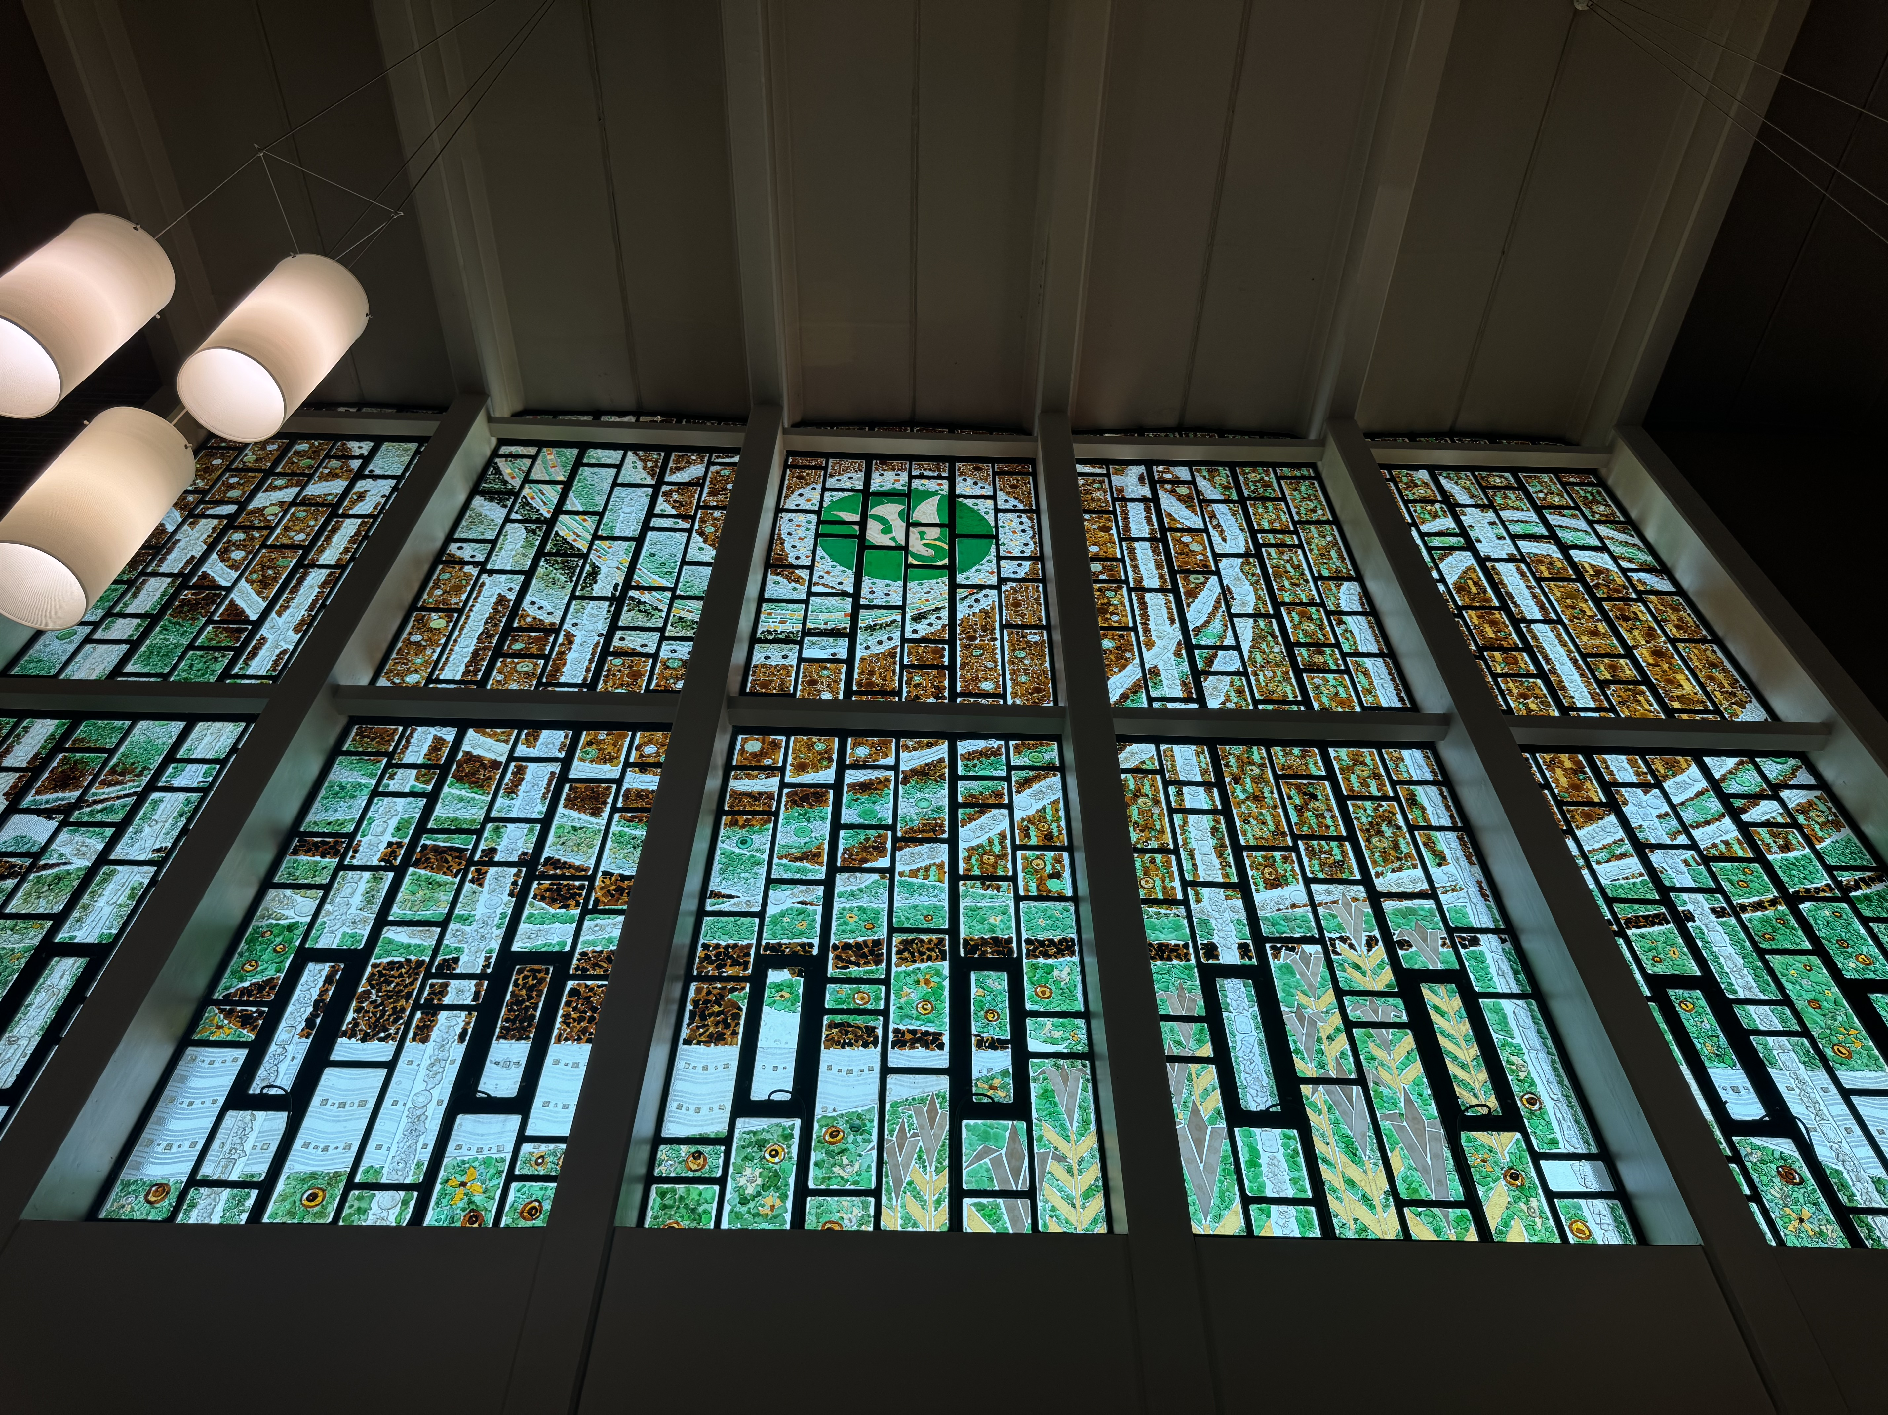
How can we be a more joy-filled school?
Notes:
Question
The Chapel window
Parable for our times out of fractured materials comes beauty and wisdom
Our fractured times

Slide 4
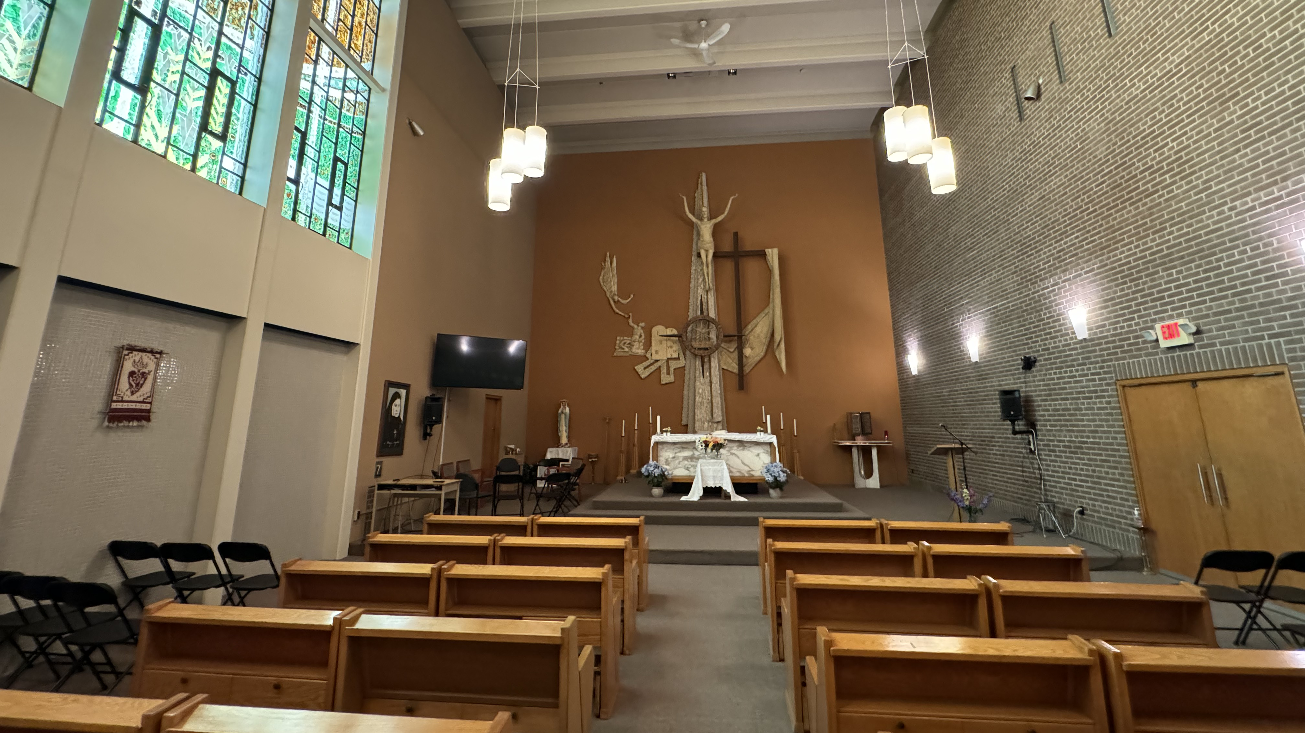
Notes:
-The cross and the brokenness
-We are all crucified in different ways
-All broken like these shards of Glass

Slide 5
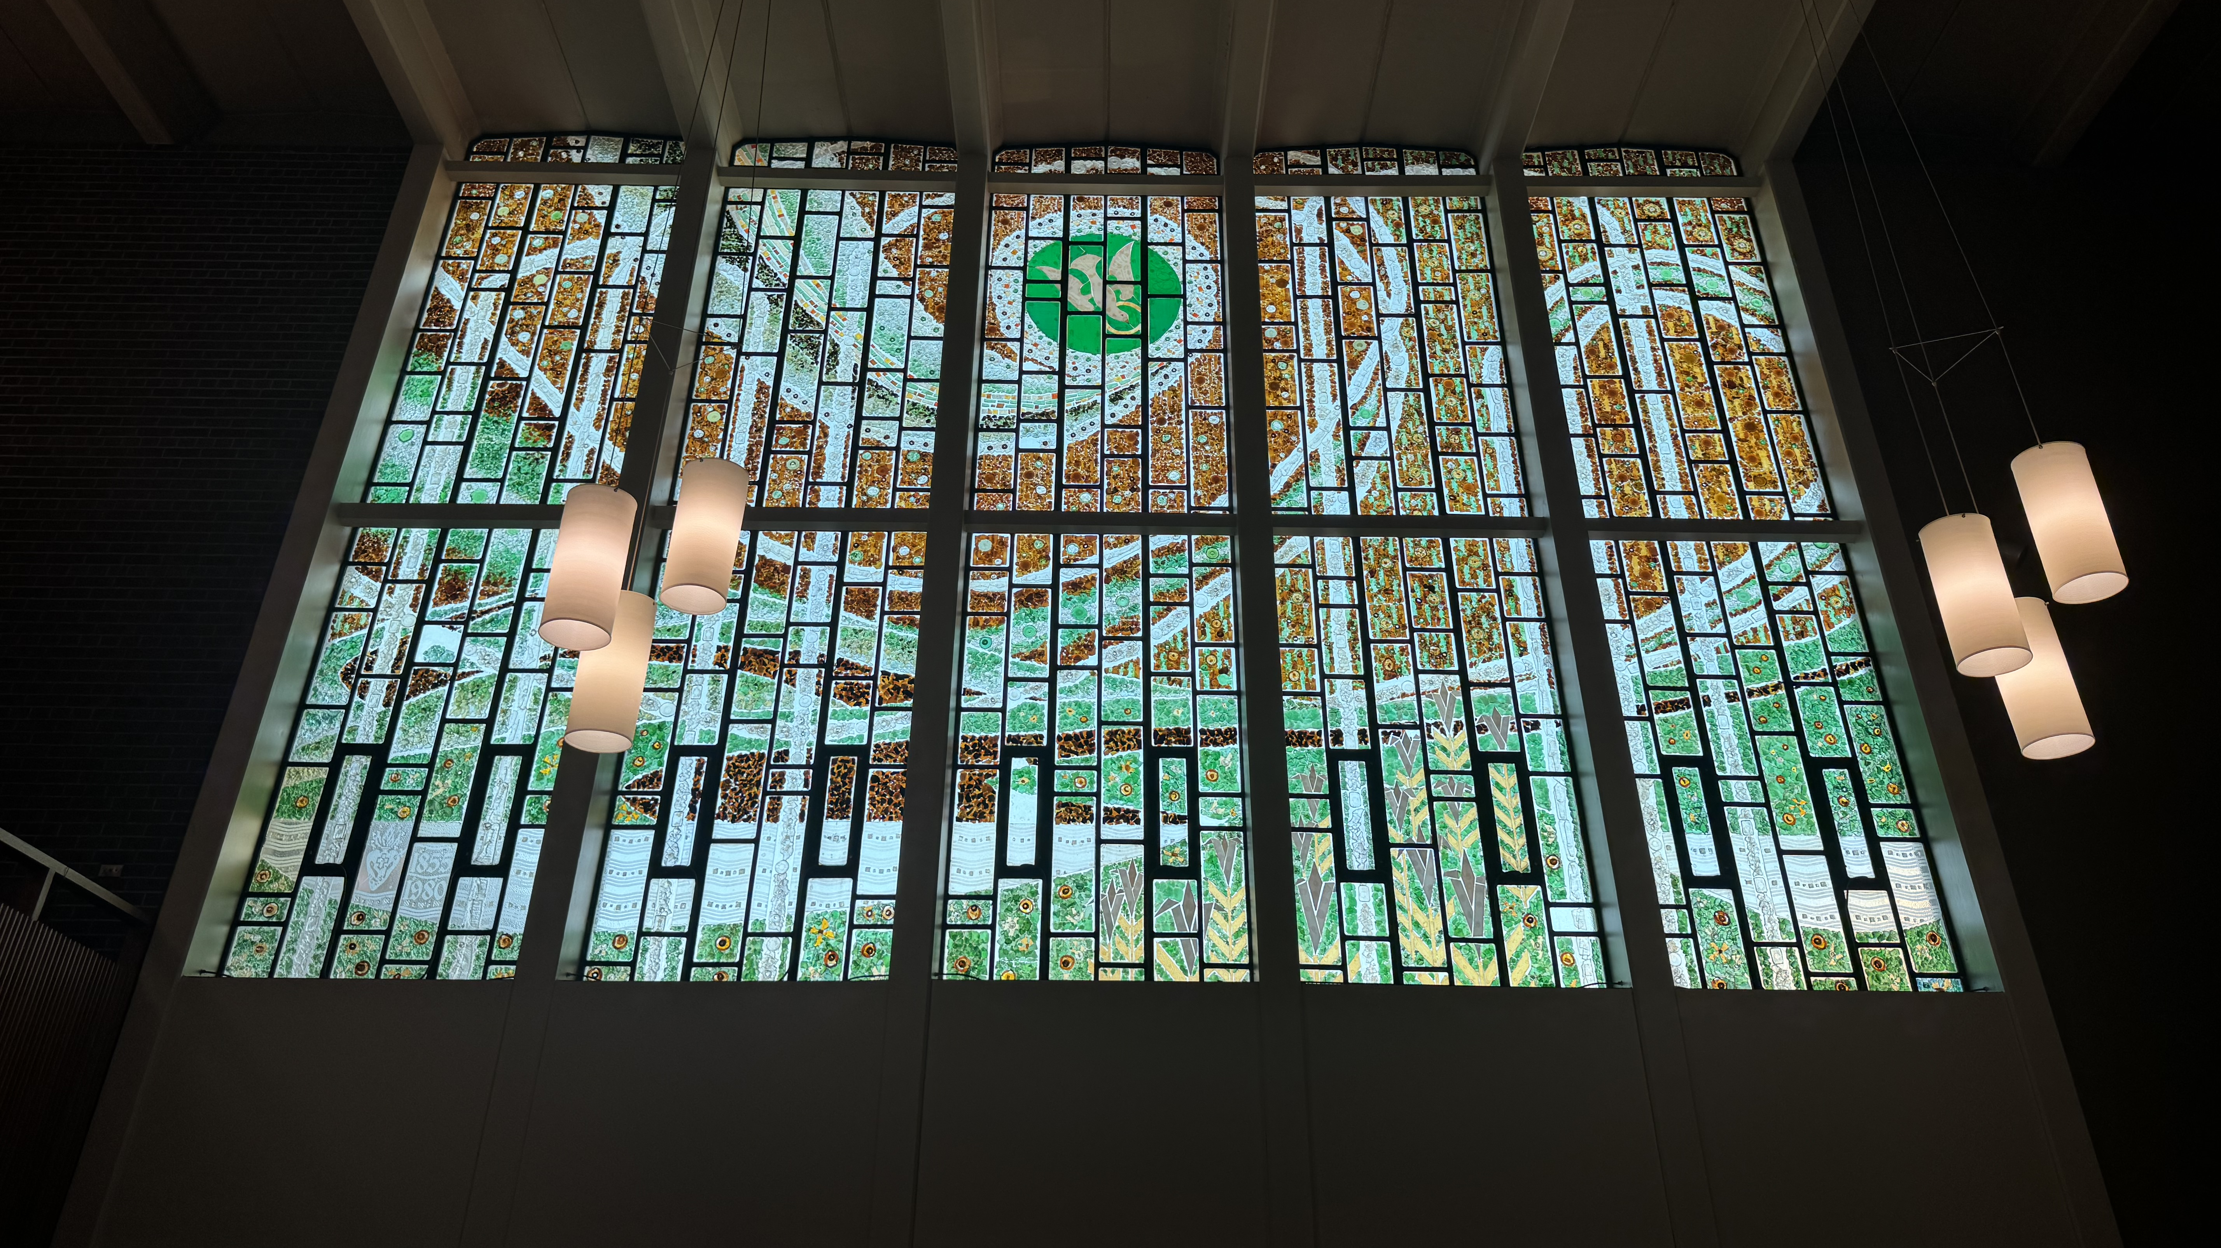
Visio Divina
Notes:
-What is Visio Divina?
-Preparation
-VD as a teaching tool
-VD as an act of spiritual curation

Slide 6
Notes:
Gazing
See ing
Feeling
Where is the sacred?
Close-ups of the window

Slide 7
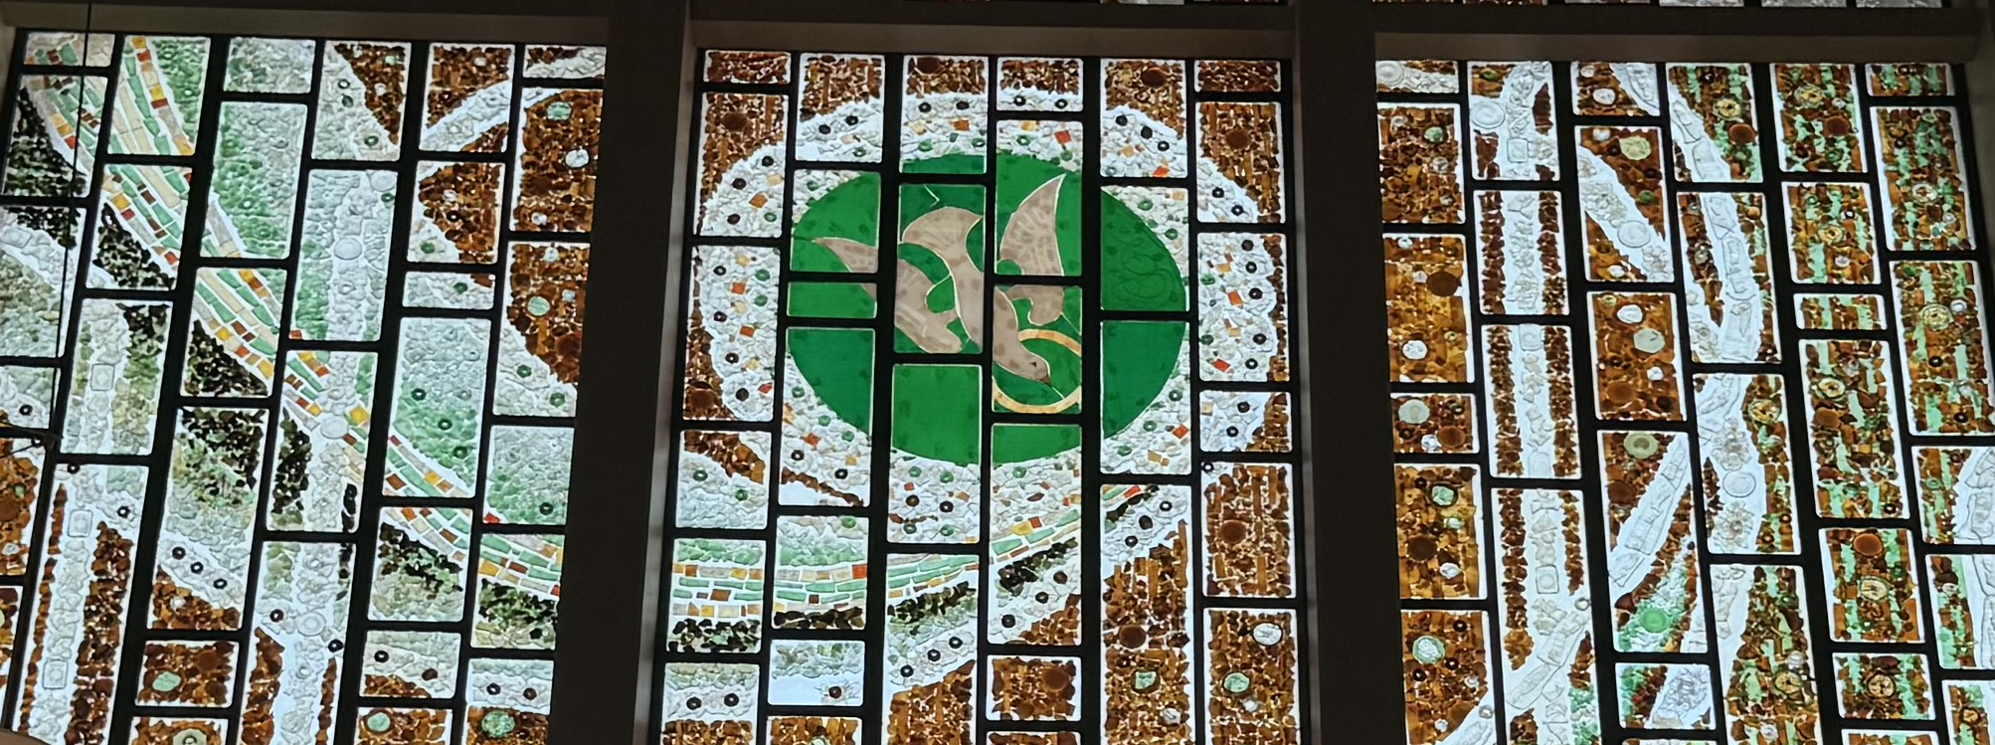
Notes:
Holy Spirit
Halo
Colours: White and green
Jeweled outer halo

Slide 8
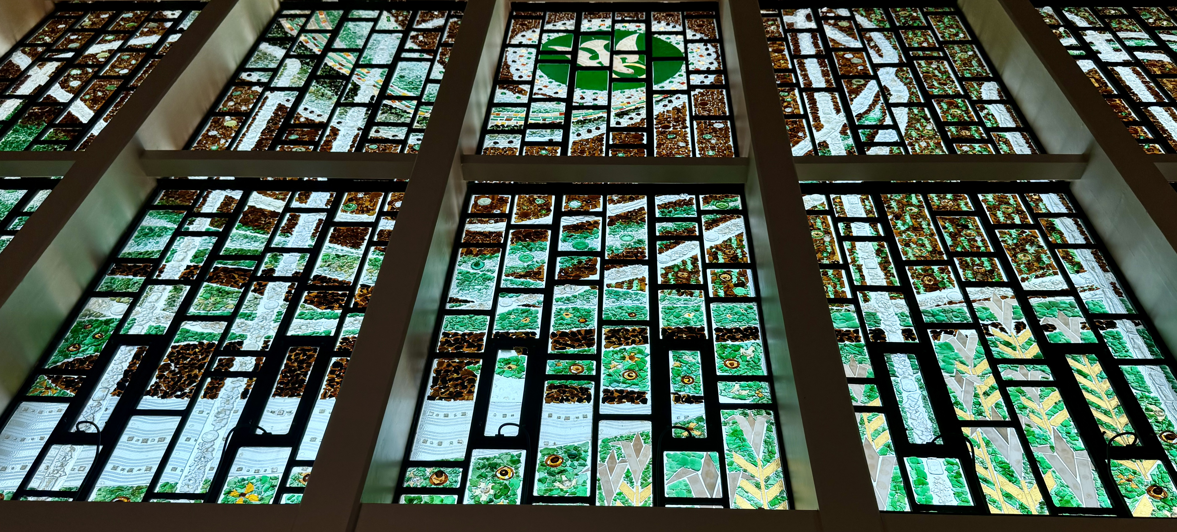
Notes:
Flowing lines … Holy Spirit blessing the world
Eighteen flowers
Chi Rho?
Bottom left, clear glass of the Sea of Galilee

Slide 9
Notes:
Reflecting
Gospel
Where do you sense the sacred?
Place yourself in a field in Galilee with the wind rushing over you: What are you feeling?

Slide 10
Notes:
Considering
What do you see? (shared)
Where is joy here?
Mosaic fragments as glimpses of grace
Your insights, what glimpses of grace are you seeing here?
Sr Colette’s insights

Slide 11
Notes:
Resting
Prayer isn’t just communicating, it’s abiding
Abiding as beholding, being

Slide 12
Notes:
Acting
Personal conclusions: what do you want to remember?
How does it help you on your spiritual journey?
What are the practical teaching implications…are their ways of applying this to different subjects?
How does it help us to be more joyful? (the joy of insight)

Slide 13
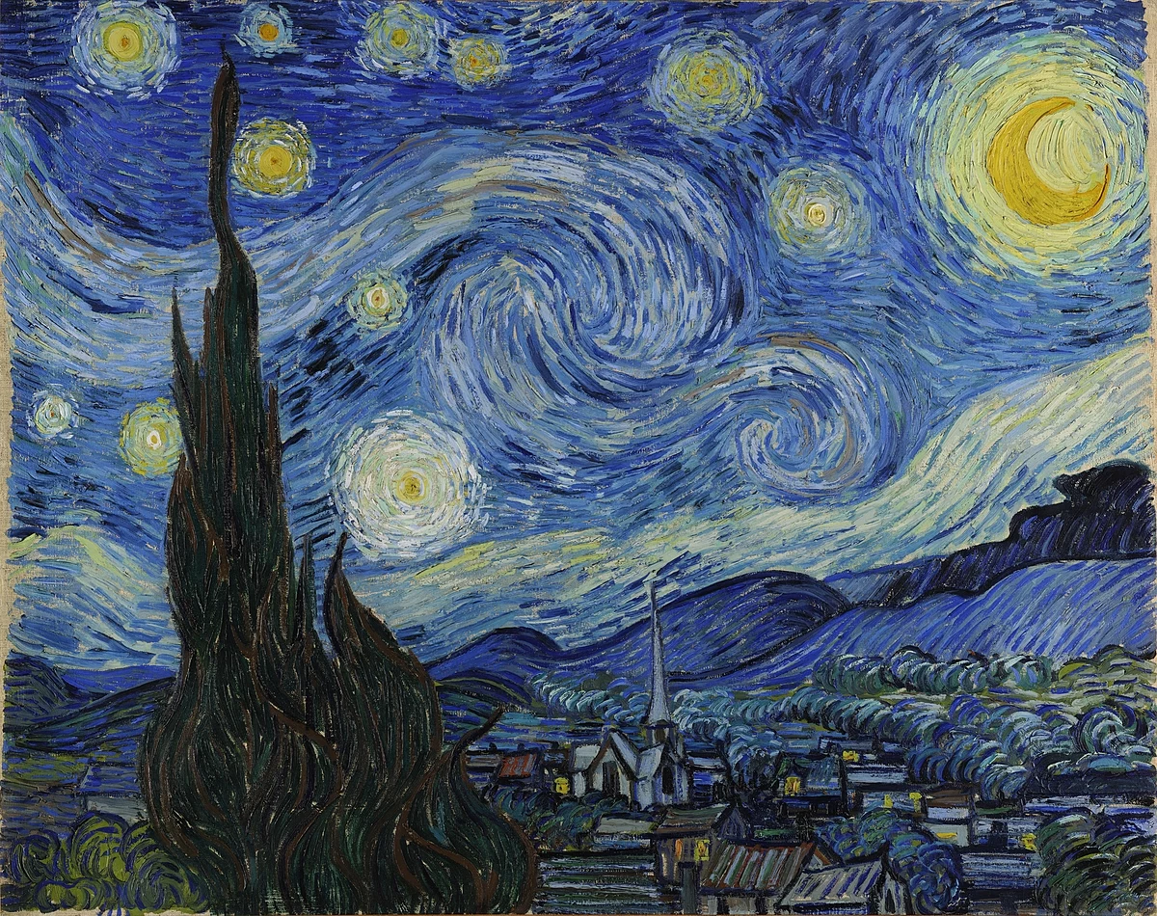
Cultivating Joy
Notes:
Images that can be used for Visio Divina
VD, has several forms
Here they are used as a thematic version of Visio Divina that uses varieties of art to delve into the theme of joy.
We prepare ourselves by opening ourselves to the Holy Spirit. As we consider different art works, we ponder the question, what can we learn about joy from this encounter?

Slide 14
Notes:
First we’ll turn to a familiar painting by Van Gogh
Similarities to the chapel window
Two spires above a dark world under the dancing heavens. The burning bush echoed in the steeple pointing to beauty.
I am that spire, learning from the burning bush
Scripture: Mt 28:19
My vocation as a Catholic educator is to joyfully point to beauty and wonder

Slide 15
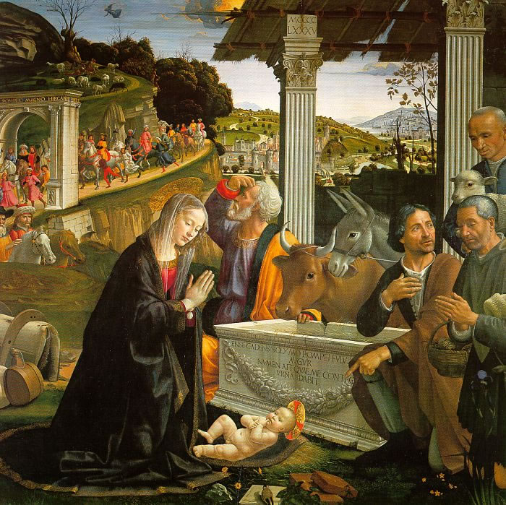
Notes:
Ghirlandaio’s Adoration of the Shepherds

Slide 16
Notes:
Contrasting gaze
Holy family as a symbol of what it means to be a Christian educator
Eyes on Christ
Eyes on what is coming down the road
Link to window beauty amid the brokenness

Slide 17
Notes:
Eyes on Christ _ Mary
Eyes on what is coming down the road – Joseph
Spiritual bifocal: Eyes on Christ, eyes on the world

Slide 18
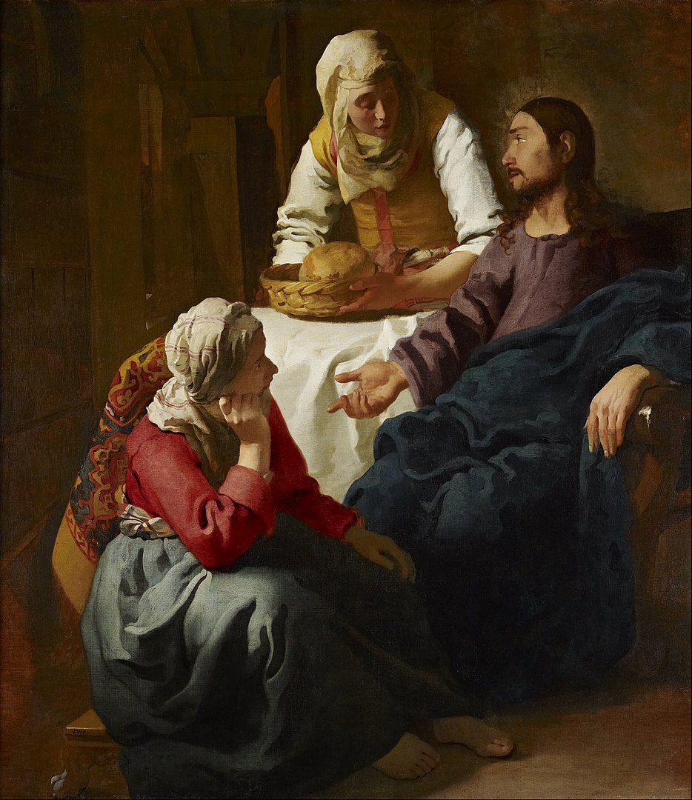
Notes:
Vermeer,
Christ in the House of Martha and Mary
Unity of Martha and Mary
Action and contemplation: Felician “Contemplatives in action”
Joy in finding balance.
What does it mean? Take some time for sitting at the feet of wisdom

Slide 19
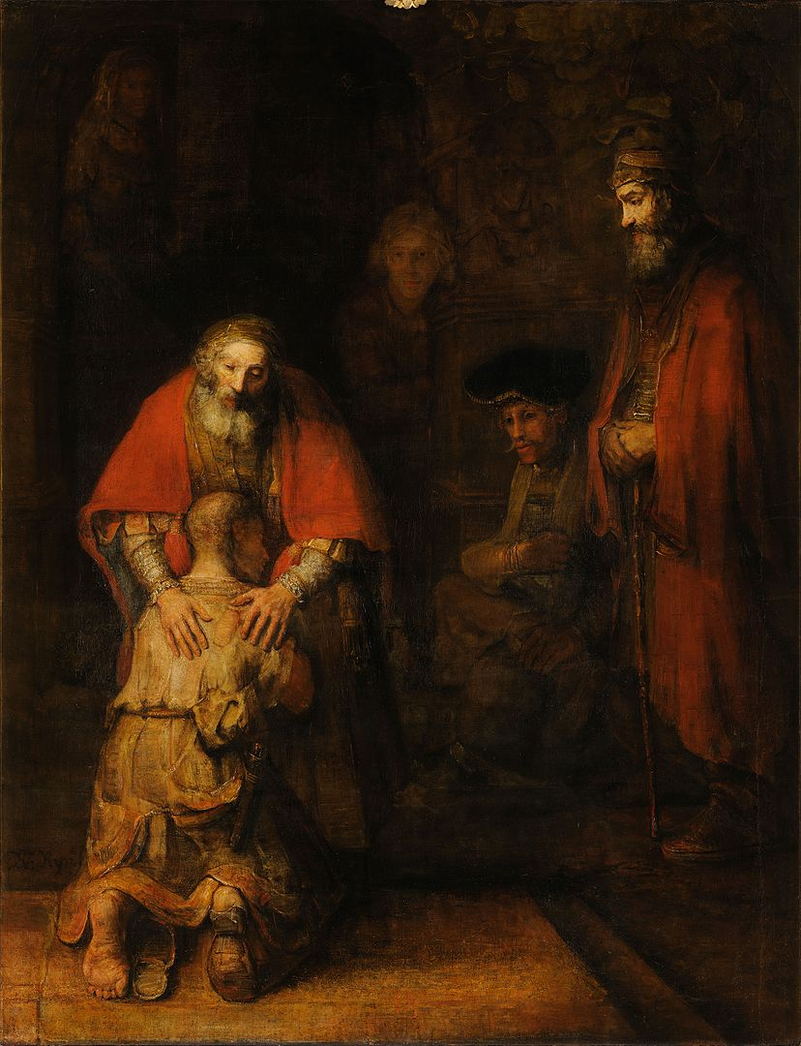
Notes:
Rembrandts Prodigal Son
context – story – resonates through time: original, Jesus, Luke, Rembrandt, Fr. Henri Nouwen, myself, yourself

Slide 20
Notes:
`

Slide 21
Notes:
The elder son
Resembles the father
But has a challenge: hands, (condemnation or blessing?) gaze gratitude or resentment)
Resentment as a barrier to joy
Gratitude as the parent of joy.
If you want to be joyful, be grateful

Slide 22
Notes:
The Father
Finding joy in being, being grateful.
Gratitude in seeing the sacred, not just in art but in the moments of everyday life;
Br David Steindl-Rast
Stop. Look. (Appreciate). Go.
See Rembrandt
When we do this we realize that life is blessed.
When we can bless others.
WB Yeats Vascillation
My fiftieth year had come and gone, I sat, a solitary man, In a crowded London shop, An open book and empty cup On the marble table-top. While on the shop and street I gazed My body of a sudden blazed; And twenty minutes more or less It seemed, so great my happiness, That I was blessed and could bless.

Slide 23
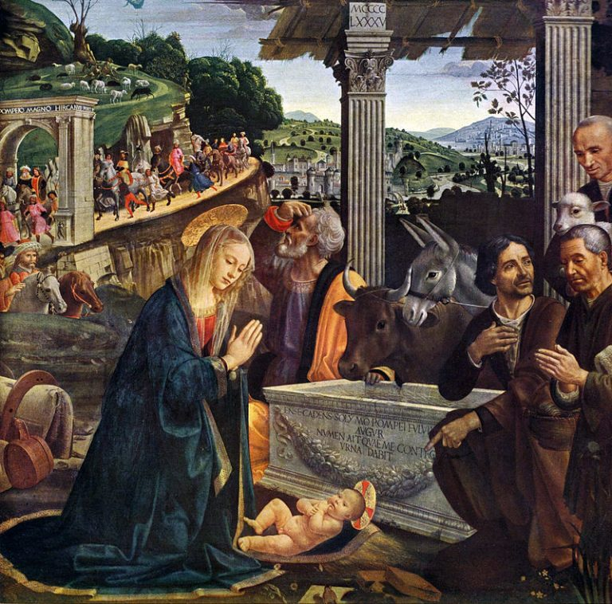
Notes:
Resting: How is the sacred present to you in these images?

Slide 24
Which insights from today’s presentation can help your school year be more joyful?
Notes:
Acting: Which insights from today’s presentation can help your school year be more joyful?

Slide 25
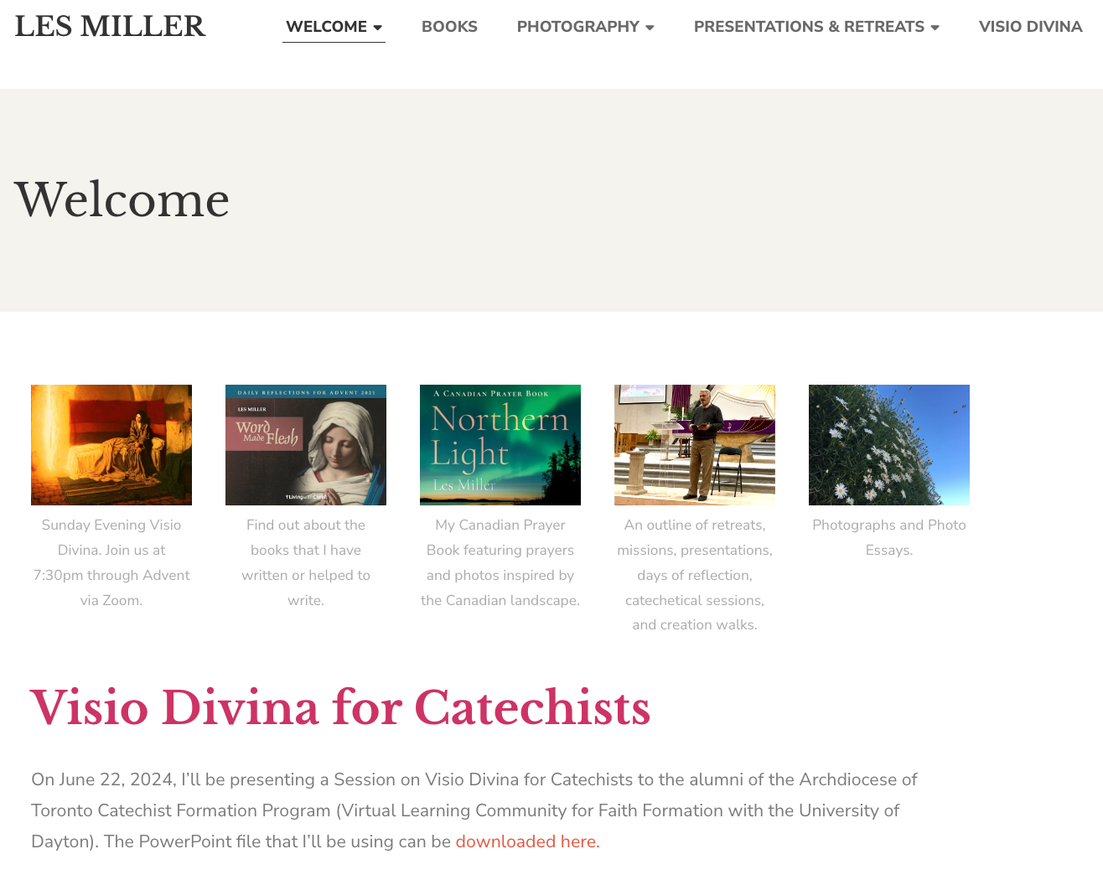

Resources: lesmiller.ca and Northern Light

Slide 26
Prayer for the Beginning of the School Year
Notes:
Blessed are we ministers of the sacrament of listening.
Blessed are we who hear the voice of the vulnerable and scarred.
Blessed are we who hear the cry of the earth and the cry of the poor.
Blessed are we ministers of the sacrament of peacemaking.
Blessed are we who seek the eyes of Jesus in the midst of our storms.
Blessed are we who seek harmony.
Blessed are we ministers of the sacrament of prayer.
Blessed are we who reach up and reach out and reach within for sacred presence.
Blessed are we who just stand in the midst of creation being with the creator.
Blessed are we ministers of the sacrament of balance.
Blessed are we who are both Mary and Martha.
Blessed are those who are happy to live in the tension between certainty and chaos.
Blessed are we ministers of creativity.
Blessed are we who translate inspiration into reality.
Blessed are we who see our work as educators as deep cooperation with the Creator.
Blessed are we ministers of healing.
Blessed are we who bind wounds with forgiveness and mercy.
Blessed are we who tend the injuries of our fragile planet.
Blessed are we ministers of wisdom.
Blessed are we who see the sacred in the question.
Blessed are we who leaven information with the Holy Spirit.
Blessed are we ministers of connection.
Blessed are we who nurture our communities.
Blessed are we who are citizens of the sacred layer.
Blessed are we ministers of gratitude.
Blessed are we who pause, ponder, and proceed.
Blessed are we contemplatives in action.
Blessed are we ministers of joy.
Blessed are we whose gratefulness overflows.
Blessed are we who embrace our own blessing and bless those we serve.
Blessed are we ministers of hope.
Blessed are we pilgrims on paths of insight, wisdom, and wonder.
Blessed are we seekers of your sacred footsteps.

