Slide 1
Visions of Wonder
Praying with Art to Nurture Our Spirituality of Catechesis.

Slide 2


Slide 3
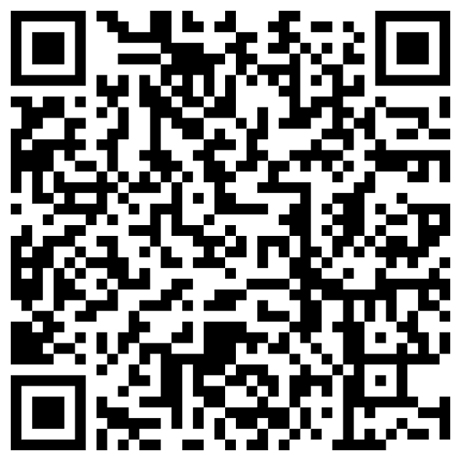
lesmiller.ca
2024: Visio Divina for Catechists

Slide 4
Catechist Spirituality
Spirituality is who we are and what we do because of what we believe.
– Sr. Janet Schaeffler
Notes:
If Spirituality is who we are and what we do because of what we believe then, Who are we? What are the images we can use to describe our ways of being a catechist and how can we nurture those paths of spirituality?

Slide 5
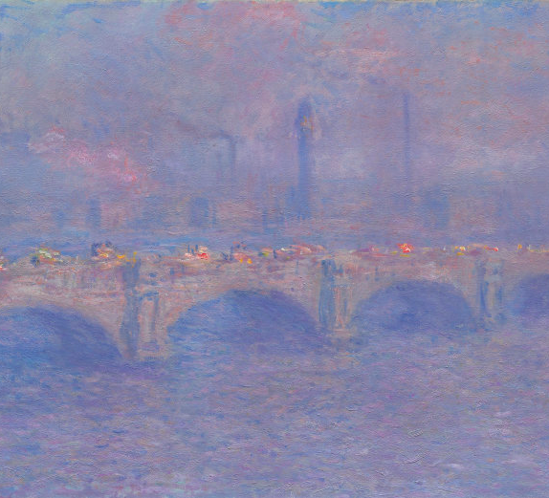
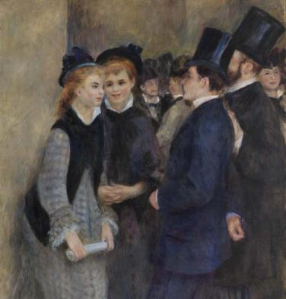
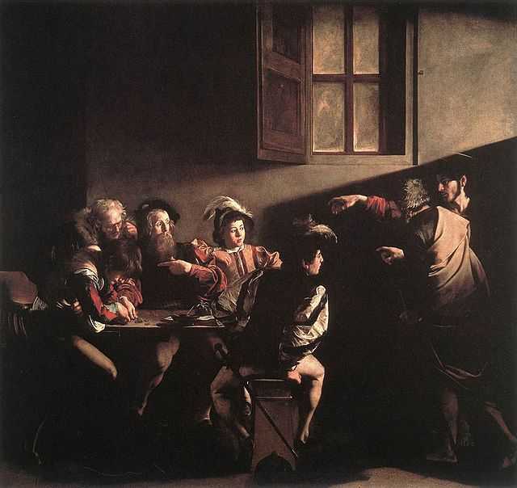
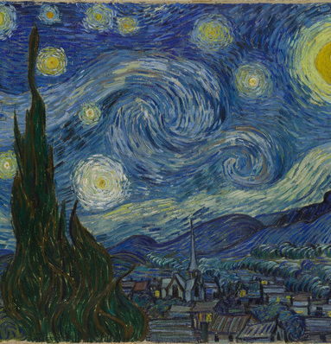
Which image reminds you most of catechesis? a. Waterloo Bridge. b. Leaving the Conservatory c. Starry Night d. Call of Matthew

Slide 6
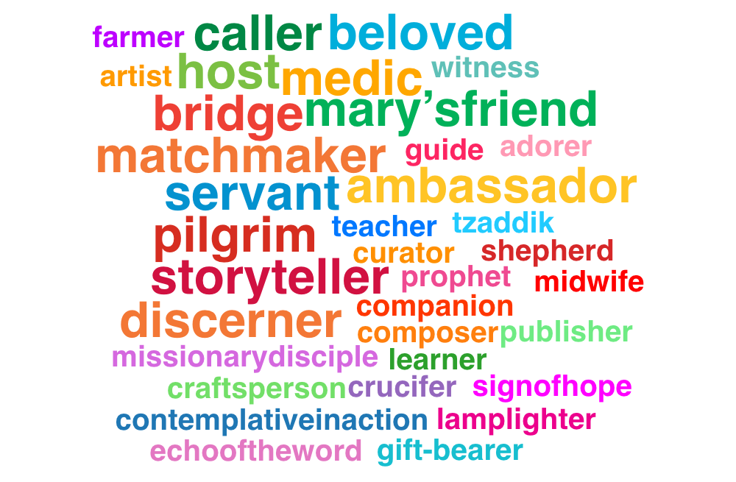
Images of the Catechist
Notes:
These images are ways in which we can understand ourselves. They are ways in which we bring our prayer into catechetical action. By looking at these images more carefully we can deepen our understanding of ourselves as catechists.

Slide 7
Our images of catechesis shapes our spirituality

Slide 8
Prayer prompts

Slide 9
Prayer Prompts
Saints
Scripture
Art
Sacred Space
DC
CCC
Wisdom

Slide 10
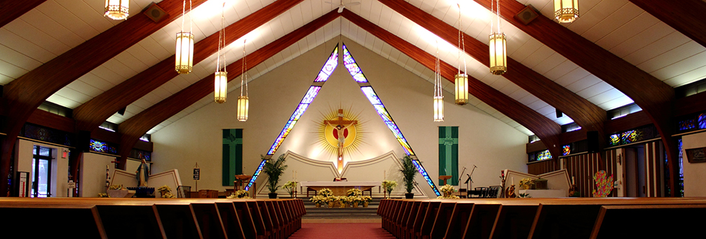

Slide 11
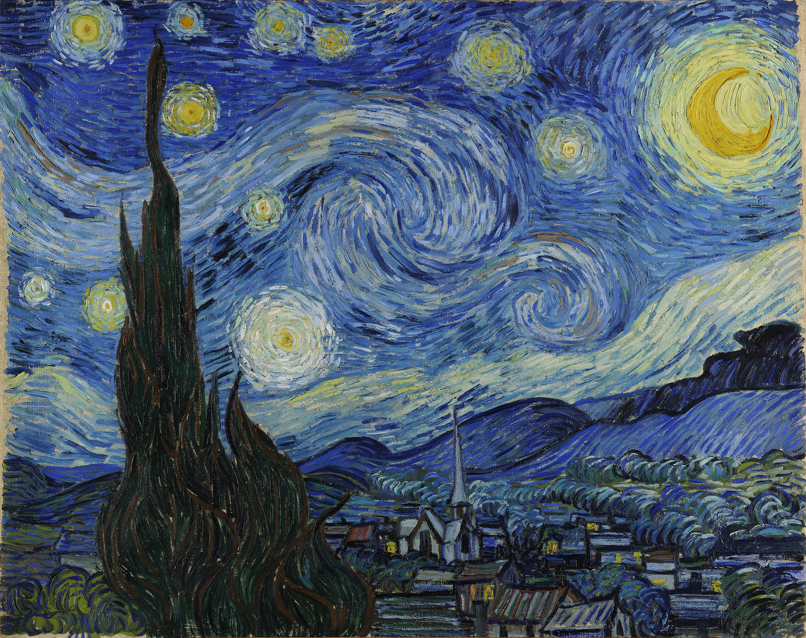
The Catechist as Curator
Notes:
Recall
Detail of painting
Point at beauty
That’s what we do.
Role of curator and docent
Give context to the glimpses of grace we experience
Breaking Open the word
How do we curate our own glimpses opf grace our own moments of holiness in our ministries?

Slide 12
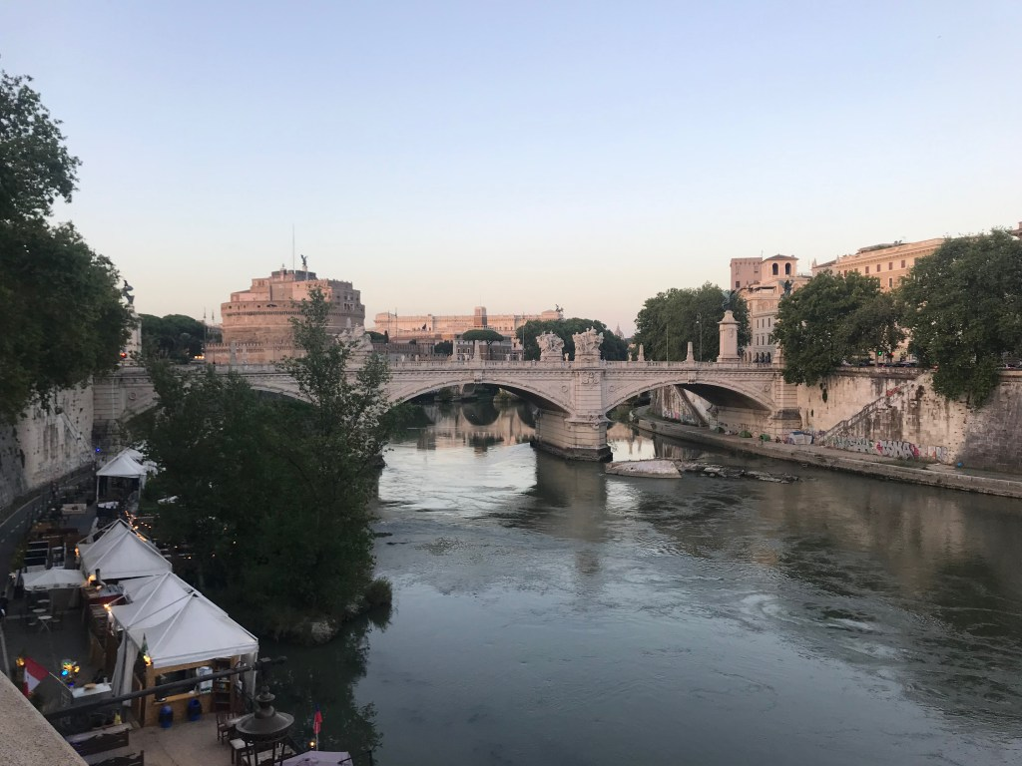
The Catechist as Bridge
Notes:
Recall Waterloo Bridge
Bridge as connector
Connect learners with God
How this photo was taken
Details
Pontifex
How we build bridges in our ministry…to God, to our true selves, to others
Narthex

Slide 13
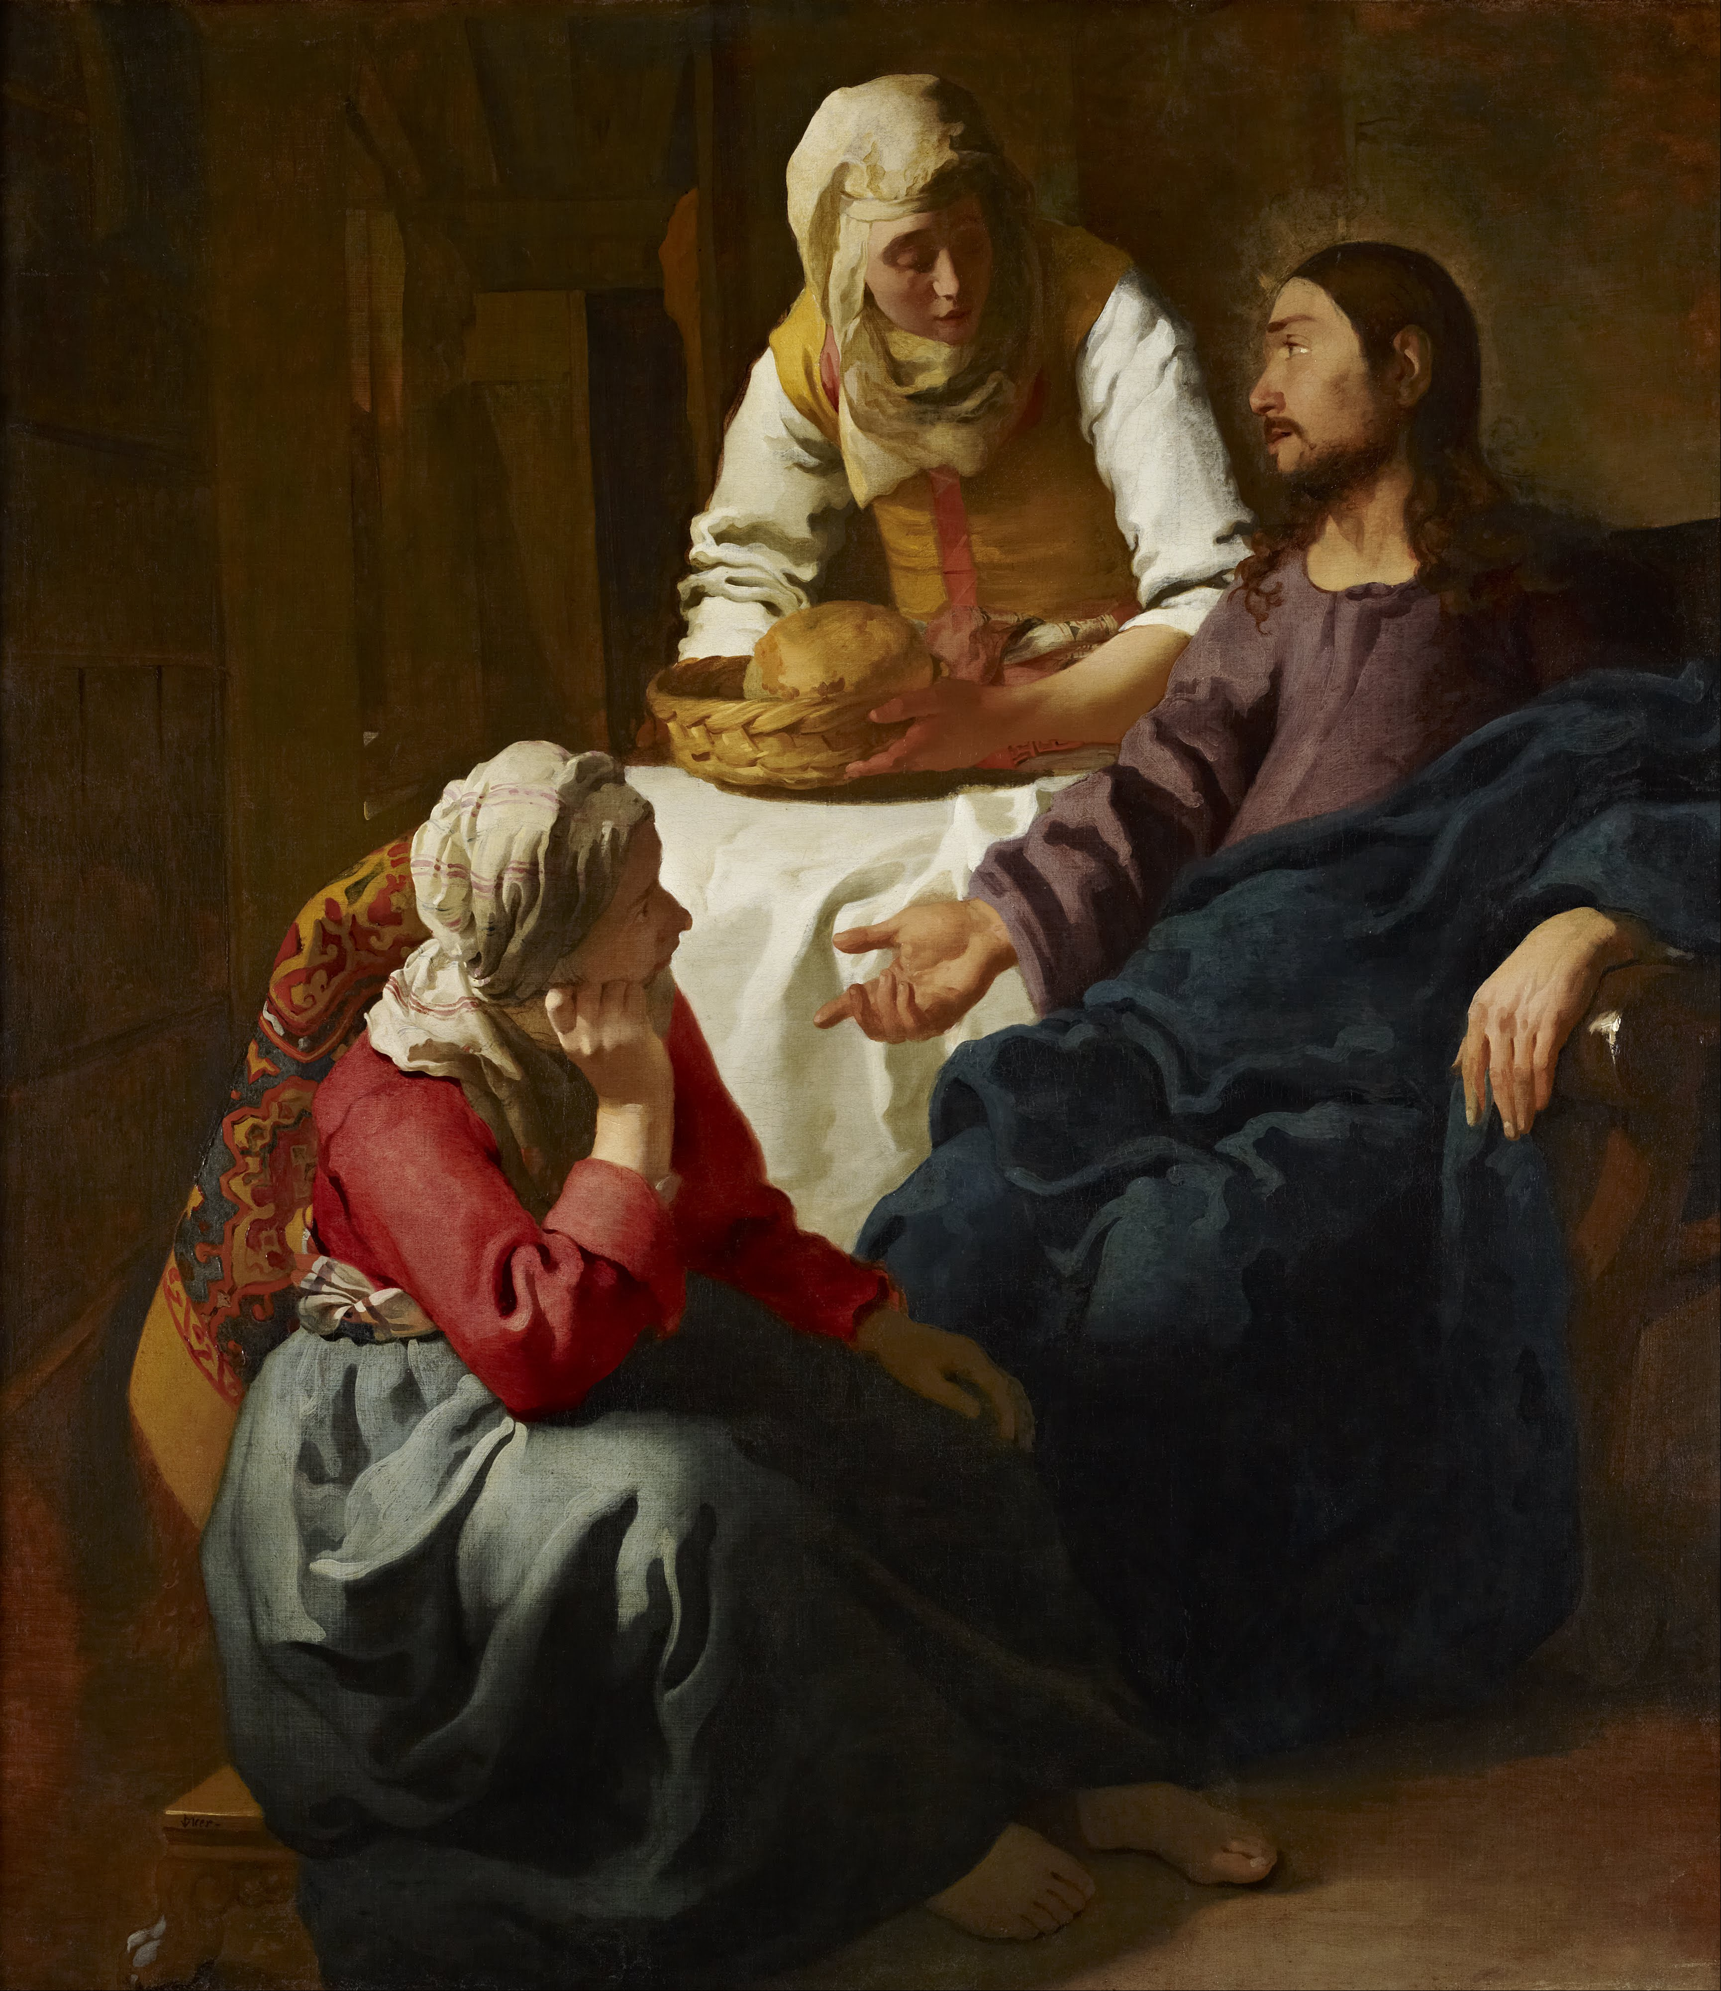
The Catechist as Contemplative in Action
Notes:
Vermeer
Universal vocation to love
Love God, love one another
Painting
Ver Meer
Situation
Prayer leads to action: St. Joseph St
Action requires prayer
Felicians
Integrity
Catechists. Our catechetical action becomes our prayer
We follow the divine pedagogical method of Jesus
Parish Bulletin

Slide 14
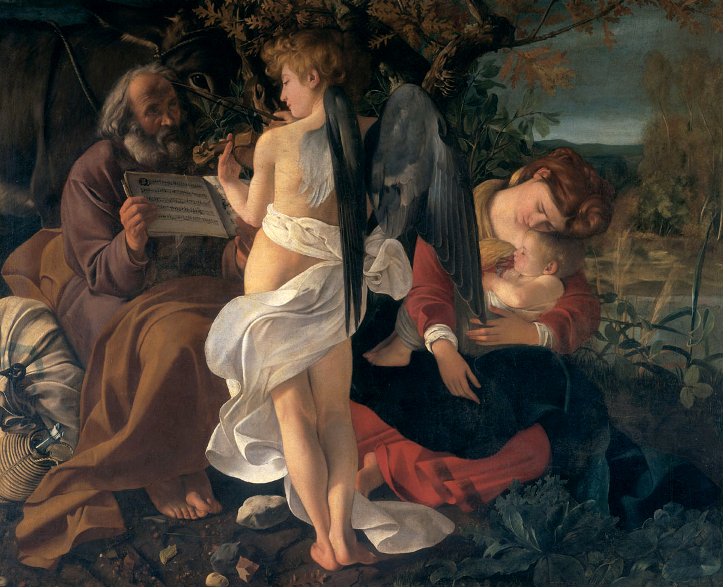
The Catechist as Mary’s Friend
Notes:
Mary is our friend
In a sense, we are St. Joseph, her companion
Painting
Mary as the first catechist…living example of nurture
How does Mary support your catechesis?

Slide 15
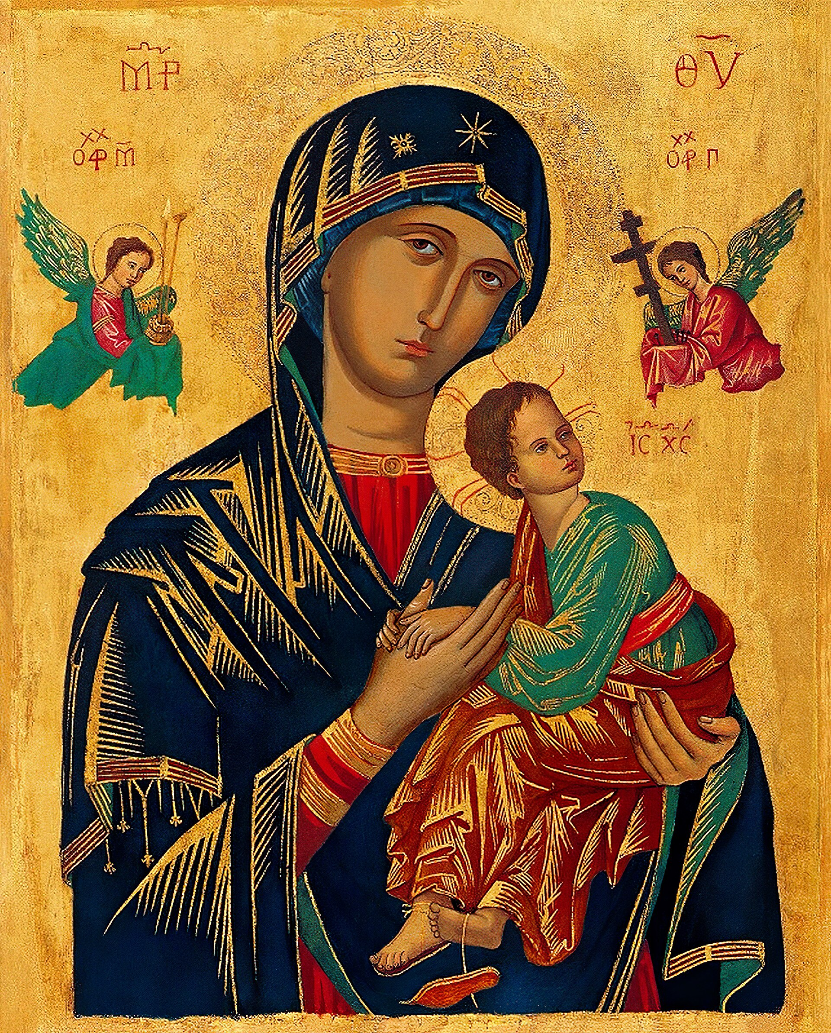
The Catechist as Saint Next Door
Notes:
Icon
Symbolism… see script
Francis and the saints next door and holiness
Gaudete et exsultate
Relic

Slide 16
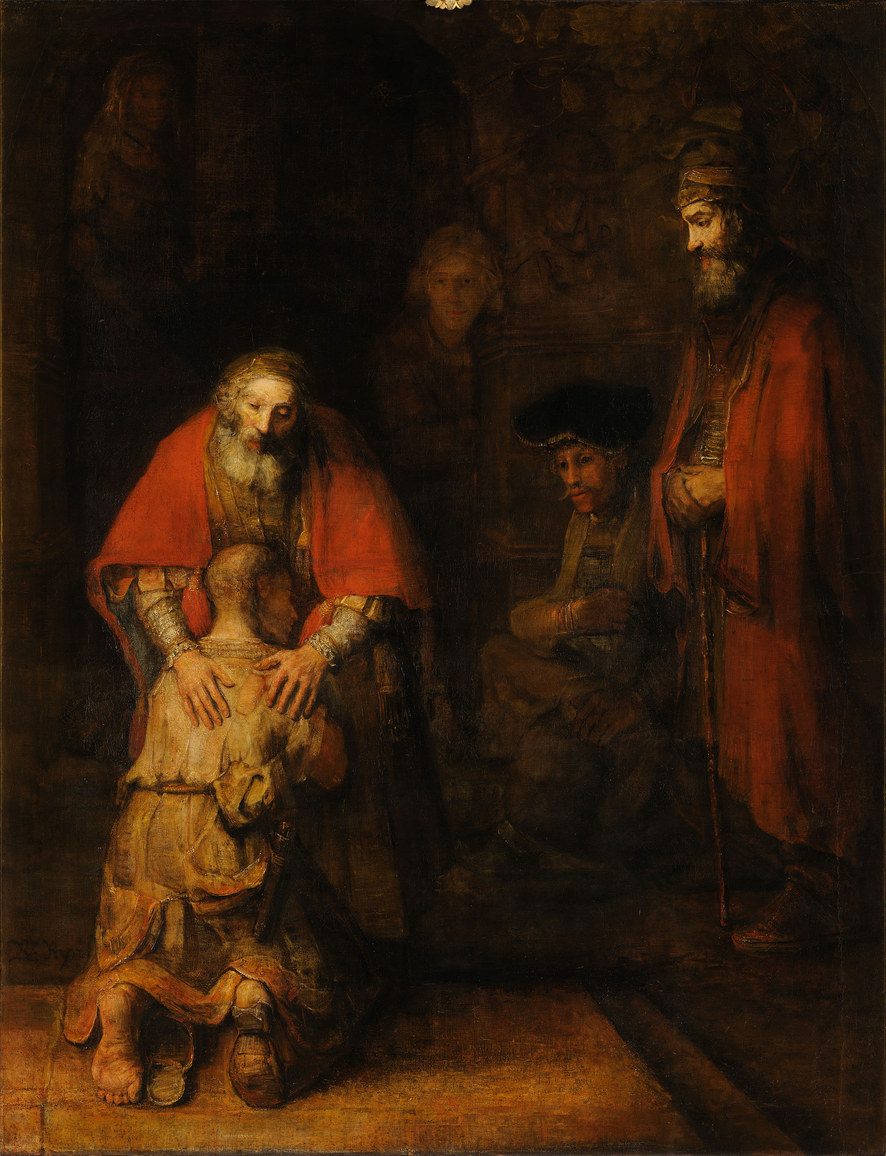
The Catechist as Storyteller
Notes:
Background to canvas
Storytellers ….Keepers of the Memory of God
Creation … Decreation … Recreation
We get to retell the stories of Jesus in our time.
When does a story become a prayer?
Stations

Slide 17
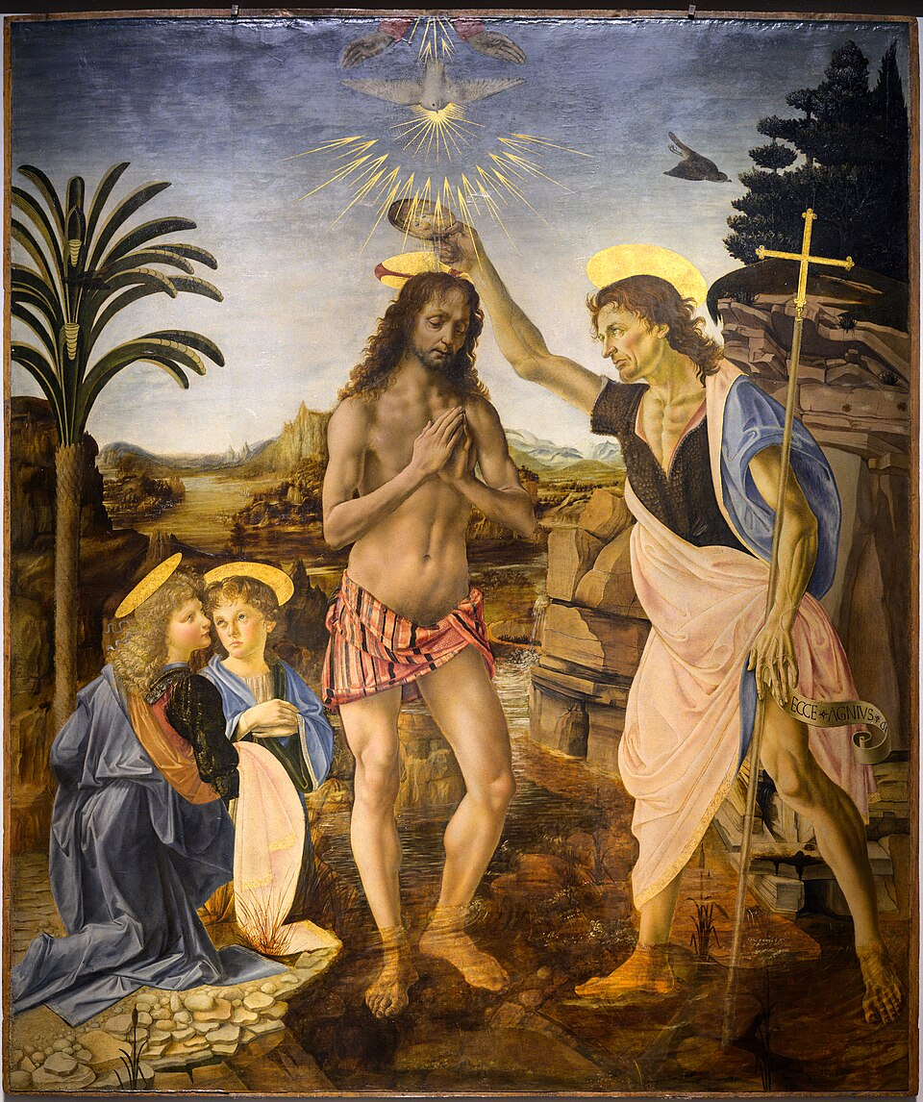
The Catechist as Beloved
Notes:
Painting by Verocchio and Leonardo
You are the beloved…we are the beloved
So we can tell others that they are the beloved.
Love
Blessing
Font

Slide 18
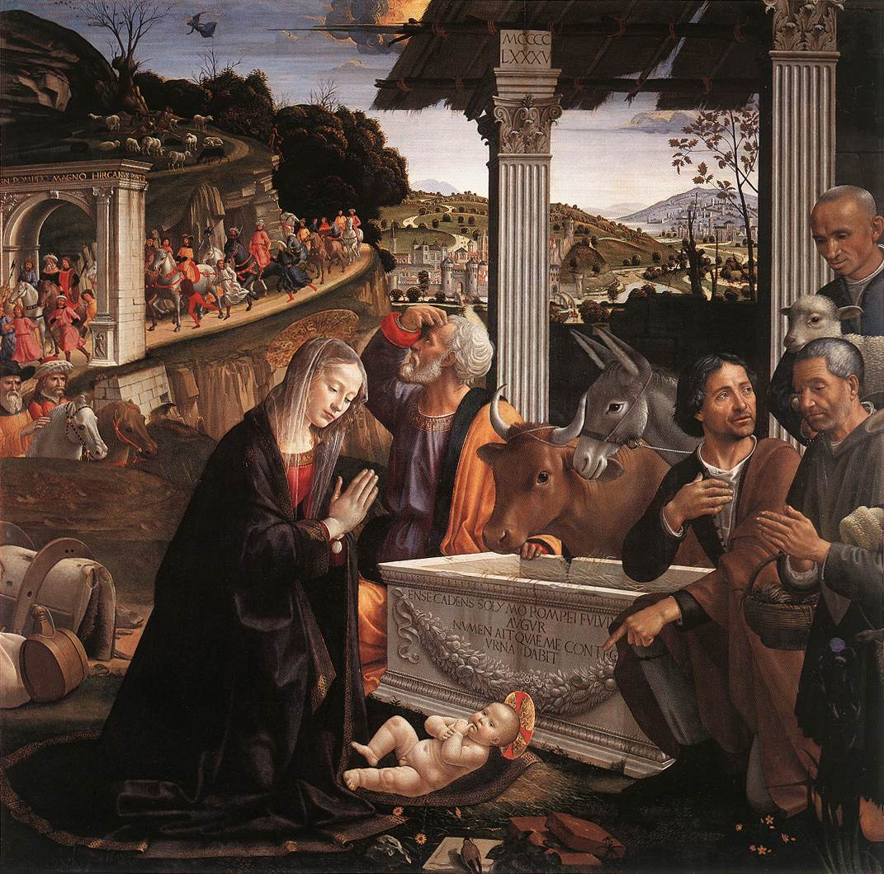
The Catechist as Adorer
Notes:
Ghirlandaio
Setting
Painting
Twin gaze as in contemplatives in action
Act of adoration on Mary’s face
Seeing -→ Gazing -→Adoration
We become what we adore
VD teaches us to see with eyes of adoration, not just Christ but the world
We model this and we are nurtured by adoration
Monstrance

Slide 19
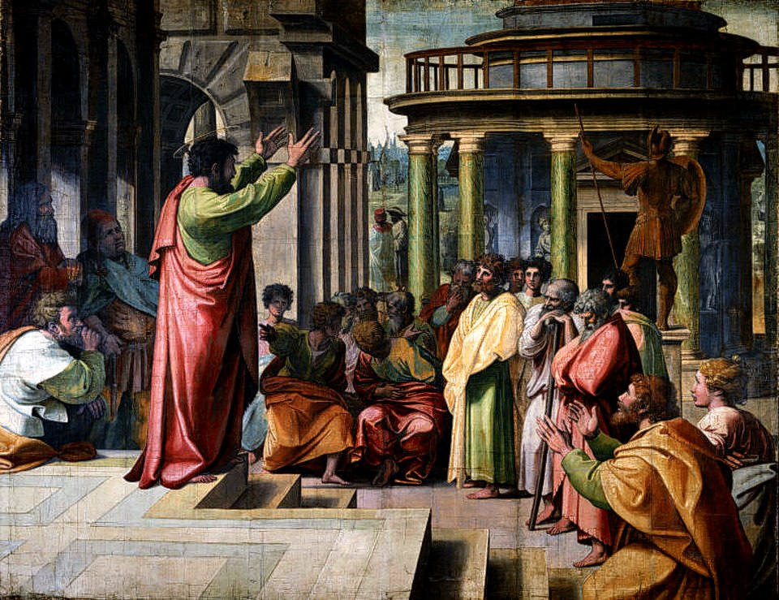
The Catechist as Interpreter
Notes:
History
Acts 17
Interpret the scriptures , message into something that can be comprehended
We are like St. Paul in Athens
In our process of enculturating the Gospel in our own lives: eg. How have you seen the Gospel played out in your life?

Slide 20
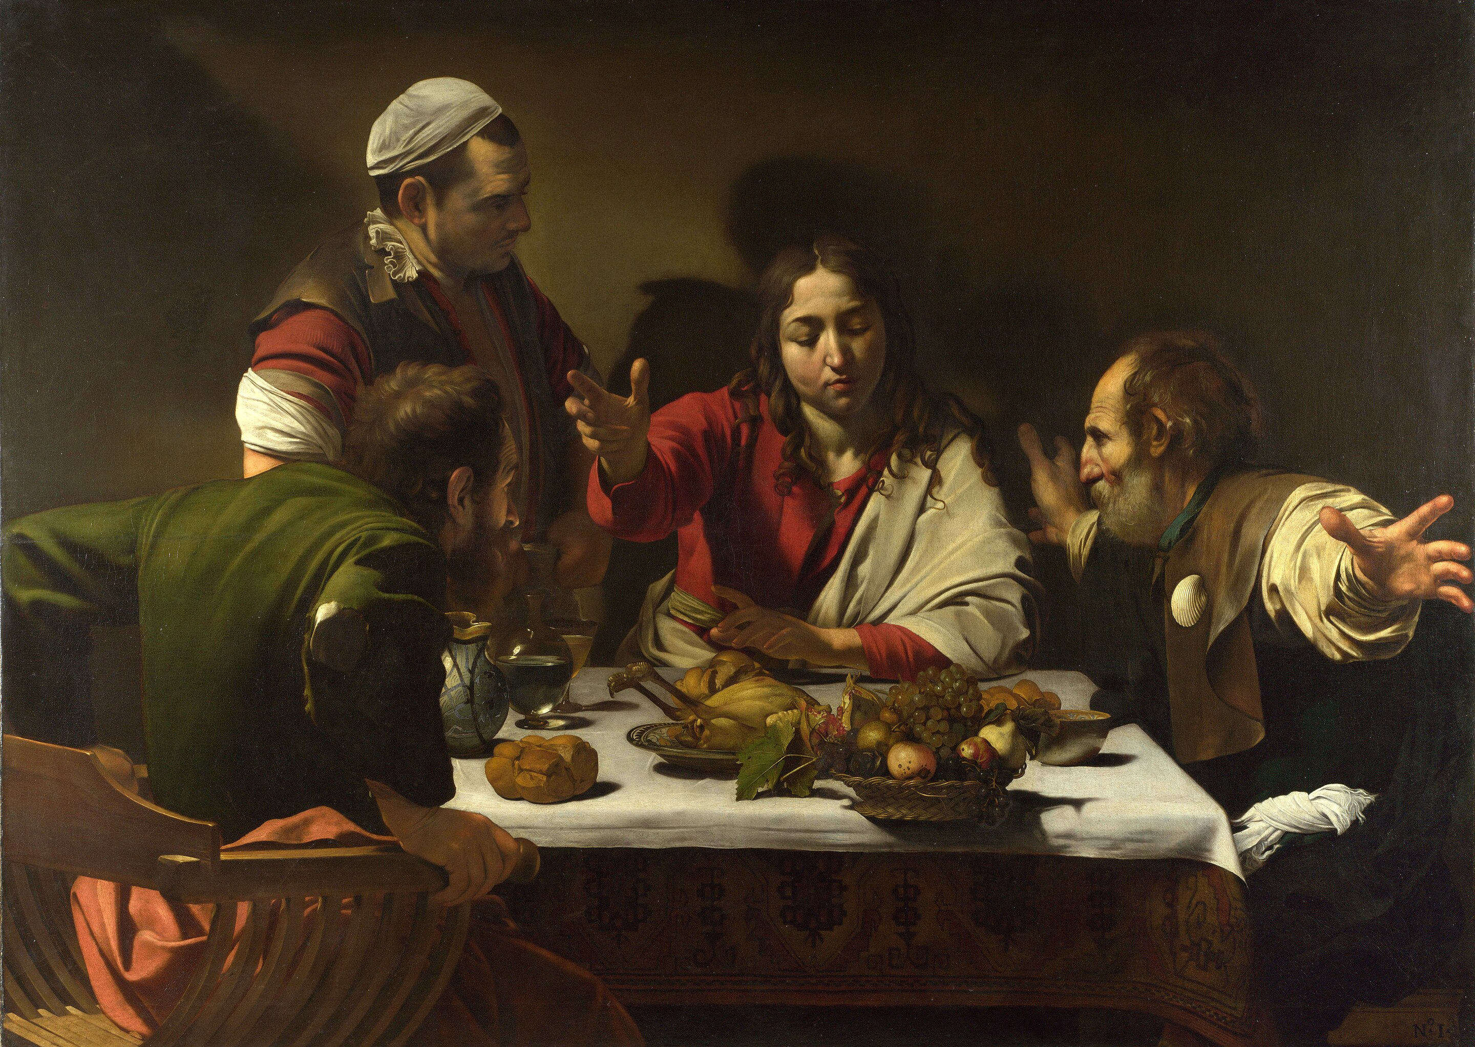
The Catechist as Companion
Notes:
Art
Emmaus
Companion
Spirituality of recognition…aha
When I get it, when the kids get it … hearts burning within us…Emmaus moments

Slide 21

The Catechist as Pilgrim of Hope

Slide 22
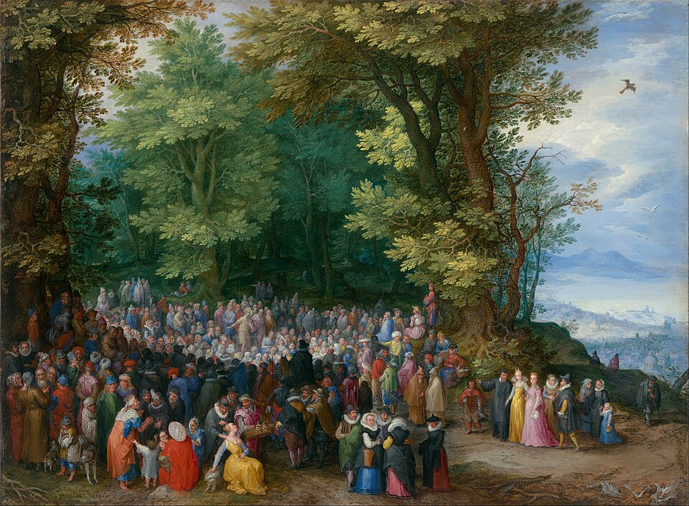
The Catechist as Teacher
Notes:
Jan Breughel the elder
Sermon on the Mount
Enculturation
We follow the teaching of Jesus,
We are called to mission
Whether we minister with adults, youth, or children, our role is not to put in, but to call forth. An important definition of education is to draw out of. Sr Janet Schaeffler
Not a banking model but more accompaniment and witness.
Ambo
Minister of the Word

Slide 23
Images of the Catechist
Notes:
These images are ways in which we can understand ourselves. They are ways in which we bring our prayer into catechetical action. By looking at these images more carefully we can deepen our understanding of ourselves as catechists.

Slide 24
lesmiller.ca

